Slide 1
Dense Matrix Algorithms
Ananth Grama, Anshul Gupta,
George Karypis, and Vipin Kumar
To accompany the text “Introduction to Parallel Computing”,
Addison Wesley, 2003.

Slide 2
Matrix Algorithms: Introduction
Due to their regular structure, parallel computations involving matrices and vectors readily lend themselves to data-decomposition.
Typical algorithms rely on input, output, or intermediate data decomposition.
Most algorithms use one- and two-dimensional block, cyclic, and block-cyclic partitionings.

Slide 3

Matrix-Vector Multiplication
We aim to multiply a dense n x n matrix A with an n x 1 vector x to yield the n x 1 result vector y.
The serial algorithm requires n² multiplications and additions.

Slide 4
Matrix-Vector Multiplication:
Rowwise 1-D Partitioning
The n x n matrix is partitioned among n processors, with each processor storing complete row of the matrix.
The n x 1 vector x is distributed such that each process owns one of its elements.

Slide 5
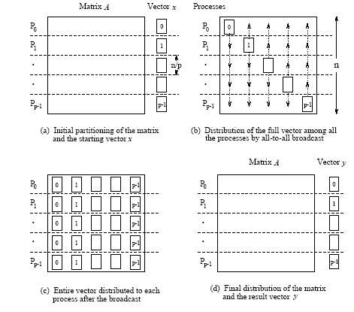
Matrix-Vector Multiplication:
Rowwise 1-D Partitioning
Multiplication of an n x n matrix with an n x 1 vector using
rowwise block 1-D partitioning. For the one-row-per-process
case, p = n.

Slide 6

Matrix-Vector Multiplication:
Rowwise 1-D Partitioning
Since each process starts with only one element of x , an all-to-all broadcast is required to distribute all the elements to all the processes.
Process P_{i} now computes .
The all-to-all broadcast and the computation of y[i] both take time Θ(n) . Therefore, the parallel time is Θ(n) .

Slide 7
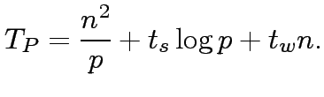
Matrix-Vector Multiplication:
Rowwise 1-D Partitioning
Consider now the case when p < n and we use block 1D partitioning.
Each process initially stores n=p complete rows of the matrix and a portion of the vector of size n=p.
The all-to-all broadcast takes place among p processes and involves messages of size n=p.
This is followed by n=p local dot products.
Thus, the parallel run time of this procedure is
This is cost-optimal.

Slide 8

Matrix-Vector Multiplication:
Rowwise 1-D Partitioning
Scalability Analysis:
We know that T₀ = pT_{P} - W, therefore, we have,
For isoefficiency, we have W = KT₀, where K = E/(1 – E) for desired efficiency E.
From this, we have W = O(p²) (from the t_{w} term).
There is also a bound on isoefficiency because of concurrency. In this case, p < n, therefore, W = n² = Ω(p²).
Overall isoefficiency is W = O(p²).

Slide 9
Matrix-Vector Multiplication:
2-D Partitioning
The n x n matrix is partitioned among n² processors such that each processor owns a single element.
The n x 1 vector x is distributed only in the last column of n processors.

Slide 10
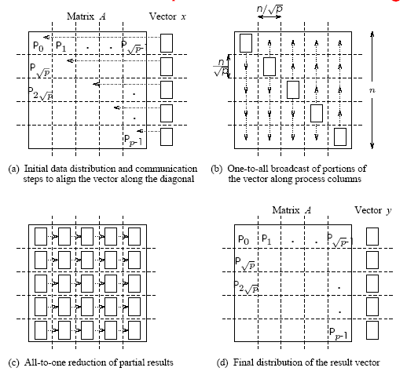
Matrix-Vector Multiplication: 2-D Partitioning
Matrix-vector multiplication with block 2-D partitioning. For the
one-element-per-process case, p = n² if the matrix size is n x n .

Slide 11
Matrix-Vector Multiplication:
2-D Partitioning
We must first align the vector with the matrix appropriately.
The first communication step for the 2-D partitioning aligns the vector x along the principal diagonal of the matrix.
The second step copies the vector elements from each diagonal process to all the processes in the corresponding column using n simultaneous broadcasts among all processors in the column.
Finally, the result vector is computed by performing an all-to-one reduction along the columns.

Slide 12
Matrix-Vector Multiplication:
2-D Partitioning
Three basic communication operations are used in this algorithm: one-to-one communication to align the vector along the main diagonal, one-to-all broadcast of each vector element among the n processes of each column, and all-to-one reduction in each row.
Each of these operations takes Θ(log n) time and the parallel time is Θ(log n) .
The cost (process-time product) is Θ(n² log n) ; hence, the algorithm is not cost-optimal.

Slide 13


Matrix-Vector Multiplication:
2-D Partitioning
When using fewer than n² processors, each process owns an block of the matrix.
The vector is distributed in portions of elements in the last process-column only.
In this case, the message sizes for the alignment, broadcast, and reduction are all .
The computation is a product of an submatrix with a vector of length .

Slide 14



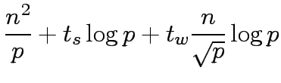


Matrix-Vector Multiplication:
2-D Partitioning
The first alignment step takes time
The broadcast and reductions take time
Local matrix-vector products take time
Total time is

Slide 15
Matrix-Matrix Multiplication
Consider the problem of multiplying two n x n dense, square matrices A and B to yield the product matrix C =A x B.
The serial complexity is O(n³).
We do not consider better serial algorithms (Strassen's method), although, these can be used as serial kernels in the parallel algorithms.
A useful concept in this case is called block operations. In this view, an n x n matrix A can be regarded as a q x q array of blocks A_{i,j} (0 ≤ i, j < q) such that each block is an (n/q) x (n/q) submatrix.
In this view, we perform q³ matrix multiplications, each involving (n/q) x (n/q) matrices.

Slide 16

Matrix-Matrix Multiplication
Consider two n x n matrices A and B partitioned into p blocks A_{i,j} and B_{i,j} (0 ≤ i, j < ) of size each.
Process P_{i,j} initially stores A_{i,j} and B_{i,j} and computes block C_{i,j} of the result matrix.
Computing submatrix C_{i,j} requires all submatrices A_{i,k} and B_{k,j} for 0 ≤ k < .
All-to-all broadcast blocks of A along rows and B along columns.
Perform local submatrix multiplication.

Slide 17

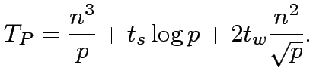
Matrix-Matrix Multiplication
The two broadcasts take time
The computation requires multiplications of
sized submatrices.
The parallel run time is approximately
The algorithm is cost optimal and the isoefficiency is O(p^{1.5}) due to bandwidth term t_{w} and concurrency.
Major drawback of the algorithm is that it is not memory optimal.

Slide 18
Matrix-Matrix Multiplication:
Cannon's Algorithm
In this algorithm, we schedule the computations of the processes of the ith row such that, at any given time, each process is using a different block A_{i,k}.
These blocks can be systematically rotated among the processes after every submatrix multiplication so that every process gets a fresh A_{i,k} after each rotation.

Slide 19
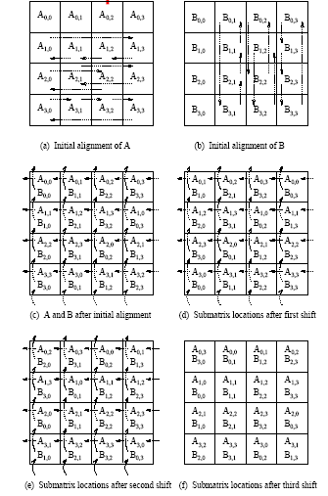
Matrix-Matrix Multiplication:
Cannon's Algorithm
Communication steps in Cannon's algorithm on 16 processes.

Slide 20
Matrix-Matrix Multiplication:
Cannon's Algorithm
Align the blocks of A and B in such a way that each process multiplies its local submatrices. This is done by shifting all submatrices A_{i,j} to the left (with wraparound) by i steps and all submatrices B_{i,j} up (with wraparound) by j steps.
Perform local block multiplication.
Each block of A moves one step left and each block of B moves one step up (again with wraparound).
Perform next block multiplication, add to partial result, repeat until all blocks have been multiplied.

Slide 21




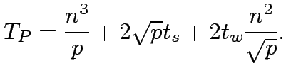
Matrix-Matrix Multiplication:
Cannon's Algorithm
In the alignment step, since the maximum distance over which a block shifts is , the two shift operations require a total of time.
Each of the single-step shifts in the compute-and-shift phase of the algorithm takes time.
The computation time for multiplying matrices of size is .
The parallel time is approximately:
The cost-efficiency and isoefficiency of the algorithm are identical to the first algorithm, except, this is memory optimal.

Slide 22
Matrix-Matrix Multiplication:
DNS Algorithm
Uses a 3-D partitioning.
Visualize the matrix multiplication algorithm as a cube . matrices A and B come in two orthogonal faces and result C comes out the other orthogonal face.
Each internal node in the cube represents a single add-multiply operation (and thus the complexity).
DNS algorithm partitions this cube using a 3-D block scheme.

Slide 23
Matrix-Matrix Multiplication:
DNS Algorithm
Assume an n x n x n mesh of processors.
Move the columns of A and rows of B and perform broadcast.
Each processor computes a single add-multiply.
This is followed by an accumulation along the C dimension.
Since each add-multiply takes constant time and accumulation and broadcast takes log n time, the total runtime is log n.
This is not cost optimal. It can be made cost optimal by using n / log n processors along the direction of accumulation.

Slide 24
Matrix-Matrix Multiplication:
DNS Algorithm
Using fewer than n³ processors.
Assume that the number of processes p is equal to q³ for some q < n.
The two matrices are partitioned into blocks of size (n/q) x(n/q).
Each matrix can thus be regarded as a q x q two-dimensional square array of blocks.
The algorithm follows from the previous one, except, in this case, we operate on blocks rather than on individual elements.

Slide 25





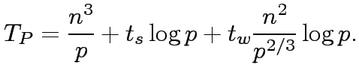

Matrix-Matrix Multiplication:
DNS Algorithm
Using fewer than n³ processors.
The first one-to-one communication step is performed for both A and B, and takes time for each matrix.
The two one-to-all broadcasts take time for each matrix.
The reduction takes time .
Multiplication of submatrices takes time.
The parallel time is approximated by:
The isoefficiency function is .

Slide 26
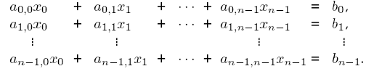
Solving a System of Linear Equations
Consider the problem of solving linear equations of the kind:
This is written as Ax = b, where A is an n x n matrix with A[i, j] = a_{i,j}, b is an n x 1 vector [ b₀, b₁, … , b_{n} ]^{T}, and x is the solution.

Slide 27
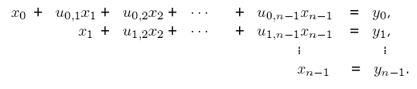
Solving a System of Linear Equations
Two steps in solution are: reduction to triangular form, and back-substitution. The triangular form is as:
We write this as: Ux = y .
A commonly used method for transforming a given matrix into an upper-triangular matrix is Gaussian Elimination.

Slide 28
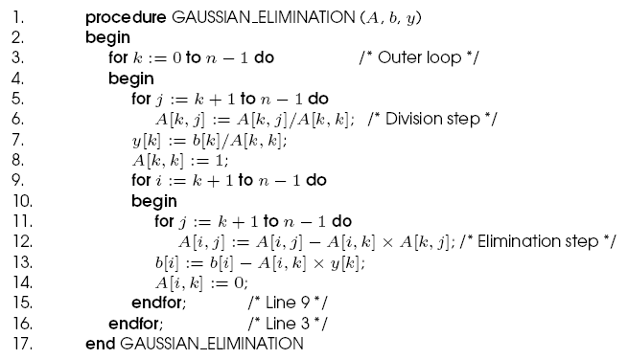
Gaussian Elimination
Serial Gaussian Elimination

Slide 29
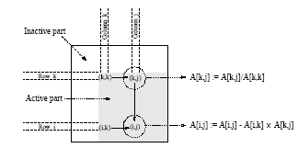
Gaussian Elimination
The computation has three nested loops - in the kth iteration of the outer loop, the algorithm performs (n-k)² computations. Summing from k = 1..n, we have roughly (n³/3) multiplications-subtractions.
A typical computation in Gaussian elimination.

Slide 30


Parallel Gaussian Elimination
Assume p = n with each row assigned to a processor.
The first step of the algorithm normalizes the row. This is a serial operation and takes time (n-k) in the kth iteration.
In the second step, the normalized row is broadcast to all the processors. This takes time .
Each processor can independently eliminate this row from its own. This requires (n-k-1) multiplications and subtractions.
The total parallel time can be computed by summing from k = 1 … n-1 as
The formulation is not cost optimal because of the t_{w} term.

Slide 31
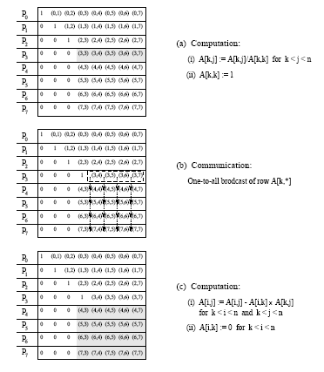
Parallel Gaussian Elimination
Gaussian elimination steps during the iteration corresponding k = 3 for an 8 x 8 matrix partitioned rowwise among eight processes.

Slide 32
Parallel Gaussian Elimination:
Pipelined Execution
In the previous formulation, the (k+1)st iteration starts only after all the computation and communication for the kth iteration is complete.
In the pipelined version, there are three steps - normalization of a row, communication, and elimination. These steps are performed in an asynchronous fashion.
A processor P_{k} waits to receive and eliminate all rows prior to k.
Once it has done this, it forwards its own row to processor Pk+1.

Slide 33
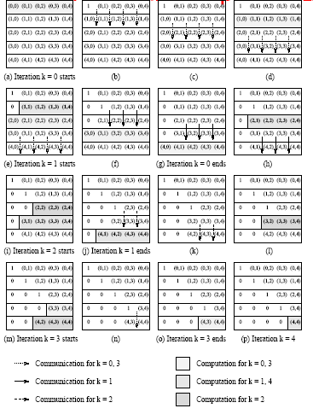
Parallel Gaussian Elimination:
Pipelined Execution
Pipelined Gaussian elimination on a 5 x 5 matrix partitioned withone row per process.

Slide 34
Parallel Gaussian Elimination:
Pipelined Execution
The total number of steps in the entire pipelined procedure is Θ(n).
In any step, either O(n) elements are communicated between directly-connected processes, or a division step is performed on O(n) elements of a row, or an elimination step is performed on O(n) elements of a row.
The parallel time is therefore O(n²) .
This is cost optimal.

Slide 35
Sorting: Overview
One of the most commonly used and well-studied kernels. Sorting can be comparison-based or noncomparison-based. The fundamental operation of comparison-based sorting is compare-exchange.
The lower bound on any comparison-based sort of n numbers is Θ(nlog n) . We focus here on comparison-based sorting algorithms.
What is a parallel sorted sequence? Where are the input and output lists stored?
We assume that the input and output lists are distributed.
The sorted list is partitioned with the property that each partitioned list is sorted and each element in processor P_{i}'s list is less than that in P_{j}'s list if i < j.

Slide 36
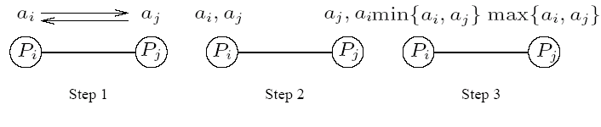
Sorting: Parallel Compare Exchange Operation
A parallel compare-exchange operation. Processes P_{i} and P_{j} send their elements to each other. Process P_{i} keeps min{a_{i},a_{j}}, and P_{j} keeps max{a_{i}, a_{j}}.

Slide 37
Sorting: Basics
What is the parallel counterpart to a sequential comparator?
If each processor has one element, the compare exchange operation stores the smaller element at the processor with smaller id. This can be done in t_{s} + t_{w} time.
If we have more than one element per processor, we call this operation a compare split. Assume each of two processors have n/p elements.
After the compare-split operation, the smaller n/p elements are at processor P_{i} and the larger n/p elements at P_{j}, where i < j.
The time for a compare-split operation is (t_{s}+ t_{w}n/p), assuming that the two partial lists were initially sorted.

Slide 38
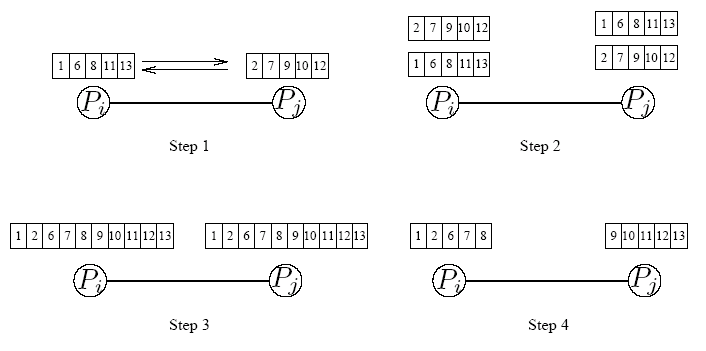
Sorting: Parallel Compare Split Operation
A compare-split operation. Each process sends its block of size n/p to the other process. Each process merges the received block with its own block and retains only the appropriate half of the merged block. In this example, process P_{i} retains the smaller elements and process P_{j} retains the larger elements.

Slide 39
Sorting Networks
Networks of comparators designed specifically for sorting.
A comparator is a device with two inputs x and y and two outputs x' and y'. For an increasing comparator, x' = min{x,y} and y' = max{x,y}; and vice-versa.
We denote an increasing comparator by ⊕ and a decreasing comparator by Ө.
The speed of the network is proportional to its depth.

Slide 40
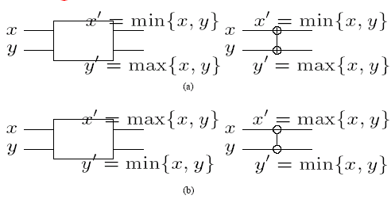
Sorting Networks: Comparators
A schematic representation of comparators: (a) an increasing comparator, and (b) a decreasing comparator.

Slide 41
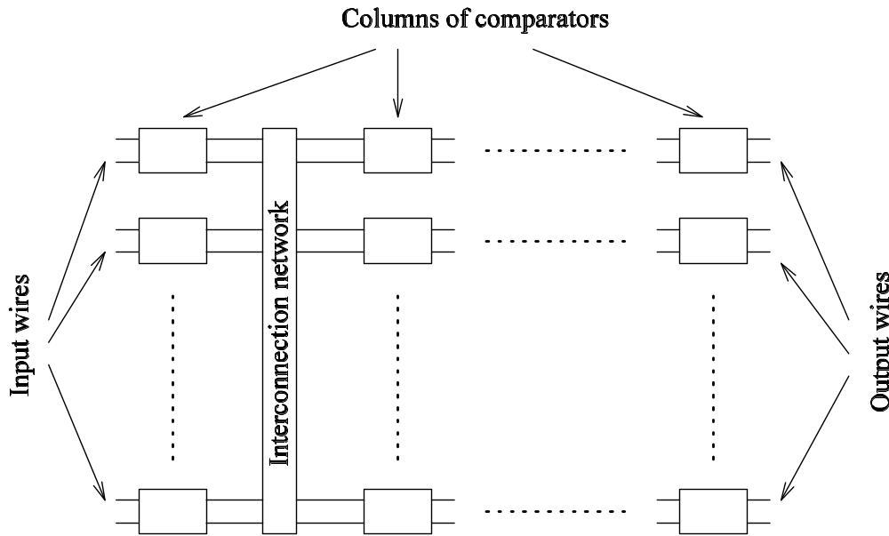
Sorting Networks
A typical sorting network. Every sorting network is made up of a series of columns, and each column contains a number of comparators connected in parallel.

Slide 42
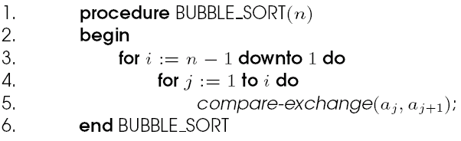
Bubble Sort and its Variants
The sequential bubble sort algorithm compares and exchanges adjacent elements in the sequence to be sorted:
Sequential bubble sort algorithm

Slide 43
Bubble Sort and its Variants
The complexity of bubble sort is Θ(n²).
Bubble sort is difficult to parallelize since the algorithm has no concurrency.
A simple variant, though, uncovers the concurrency.

Slide 44
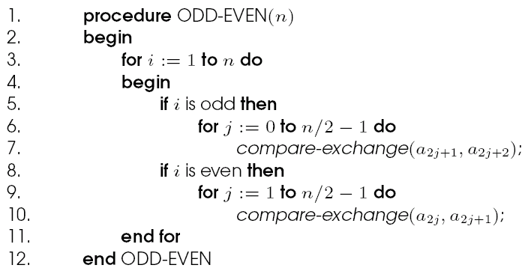
Odd-Even Transposition
Sequential odd-even transposition sort algorithm.

Slide 45
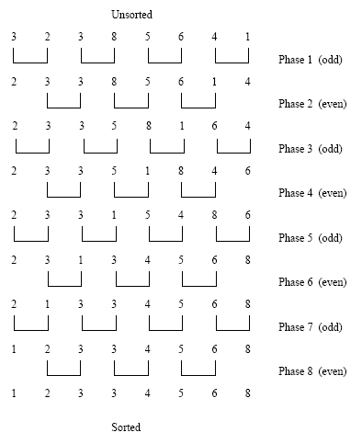
Odd-Even Transposition
Sorting n = 8 elements, using the odd-even transposition sort algorithm. During each phase, n = 8 elements are compared.

Slide 46
Odd-Even Transposition
After n phases of odd-even exchanges, the sequence is sorted.
Each phase of the algorithm (either odd or even) requires Θ(n) comparisons.
Serial complexity is Θ(n²).

Slide 47
Parallel Odd-Even Transposition
Consider the one item per processor case.
There are n iterations, in each iteration, each processor does one compare-exchange.
The parallel run time of this formulation is Θ(n).
This is cost optimal with respect to the base serial algorithm but not the optimal one.

Slide 48
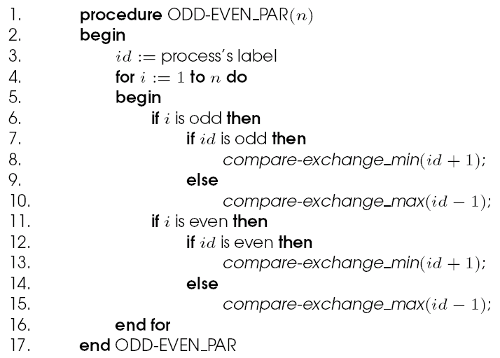
Parallel Odd-Even Transposition
Parallel formulation of odd-even transposition.

Slide 49
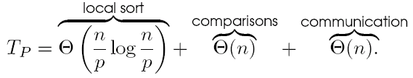
Parallel Odd-Even Transposition
Consider a block of n/p elements per processor.
The first step is a local sort.
In each subsequent step, the compare exchange operation is replaced by the compare split operation.
The parallel run time of the formulation is

Slide 50
Parallel Odd-Even Transposition
The parallel formulation is cost-optimal for p = O(log n).
The isoefficiency function of this parallel formulation is Θ(p2^{p}).

Slide 51
Shellsort
Let n be the number of elements to be sorted and p be the number of processes.
During the first phase, processes that are far away from each other in the array compare-split their elements.
During the second phase, the algorithm switches to an odd-even transposition sort.

Slide 52
Parallel Shellsort
Initially, each process sorts its block of n/p elements internally.
Each process is now paired with its corresponding process in the reverse order of the array. That is, process P_{i}, where i < p/2, is paired with process P_{p-i-1}.
A compare-split operation is performed.
The processes are split into two groups of size p/2 each and the process repeated in each group.

Slide 53
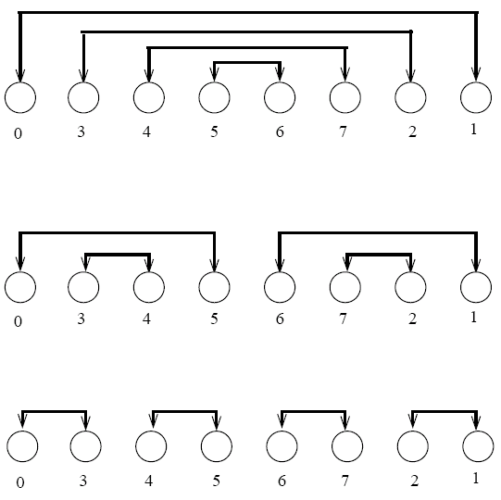
Parallel Shellsort
An example of the first phase of parallel shellsort on an eight-process array.

Slide 54
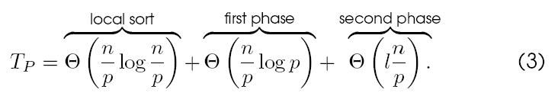
Parallel Shellsort
Each process performs d = log p compare-split operations.
With O(p) bisection width, each communication can be performed in time Θ(n/p) for a total time of Θ((nlog p)/p).
In the second phase, l odd and even phases are performed, each requiring time Θ(n/p).
The parallel run time of the algorithm is:

Slide 55
Quicksort
Quicksort is one of the most common sorting algorithms for sequential computers because of its simplicity, low overhead, and optimal average complexity.
Quicksort selects one of the entries in the sequence to be the pivot and divides the sequence into two - one with all elements less than the pivot and other greater.
The process is recursively applied to each of the sublists.

Slide 56
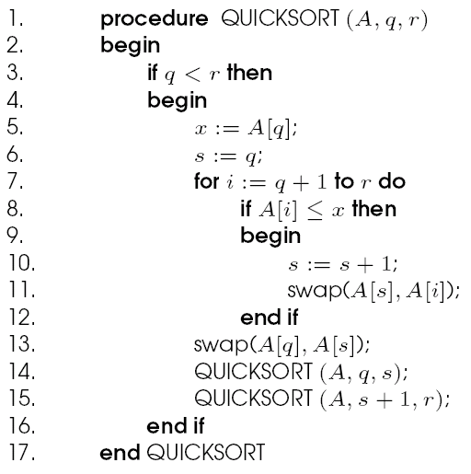
Quicksort
The sequential quicksort algorithm.

Slide 57
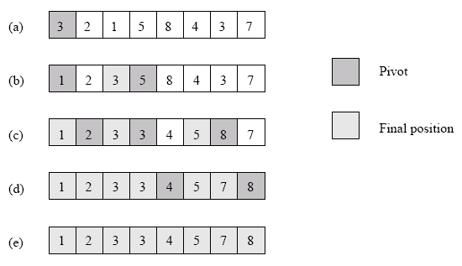
Quicksort
Example of the quicksort algorithm sorting a sequence of size n = 8.

Slide 58
Quicksort
The performance of quicksort depends critically on the quality of the pivot.
In the best case, the pivot divides the list in such a way that the larger of the two lists does not have more than αn elements (for some constant α).
In this case, the complexity of quicksort is O(nlog n).

Slide 59
Parallelizing Quicksort
Lets start with recursive decomposition - the list is partitioned serially and each of the subproblems is handled by a different processor.
The time for this algorithm is lower-bounded by Ω(n)!
Can we parallelize the partitioning step - in particular, if we can use n processors to partition a list of length n around a pivot in O(1) time, we have a winner.
This is difficult to do on real machines, though.

Slide 60
Parallelizing Quicksort: PRAM Formulation
We assume a CRCW (concurrent read, concurrent write) PRAM with concurrent writes resulting in an arbitrary write succeeding.
The formulation works by creating pools of processors. Every processor is assigned to the same pool initially and has one element.
Each processor attempts to write its element to a common location (for the pool).
Each processor tries to read back the location. If the value read back is greater than the processor's value, it assigns itself to the `left' pool, else, it assigns itself to the `right' pool.
Each pool performs this operation recursively.
Note that the algorithm generates a tree of pivots. The depth of the tree is the expected parallel runtime. The average value is O(log n).

Slide 61
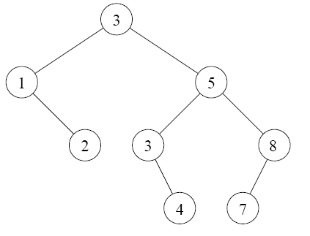
Parallelizing Quicksort: PRAM Formulation
A binary tree generated by the execution of the quicksort algorithm. Each level of the tree represents a different array-partitioning iteration. If pivot selection is optimal, then the height of the tree is Θ(log n), which is also the number of iterations.

Slide 62
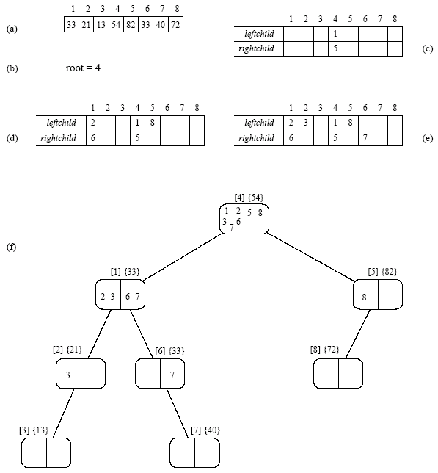
Parallelizing Quicksort: PRAM Formulation
The execution of the PRAM algorithm on the array shown in (a).

Slide 63
Parallelizing Quicksort: Shared Address Space Formulation
Consider a list of size n equally divided across p processors.
A pivot is selected by one of the processors and made known to all processors.
Each processor partitions its list into two, say L_{i} and U_{i}, based on the selected pivot.
All of the L_{i} lists are merged and all of the U_{i} lists are merged separately.
The set of processors is partitioned into two (in proportion of the size of lists L and U). The process is recursively applied to each of the lists.

Slide 64
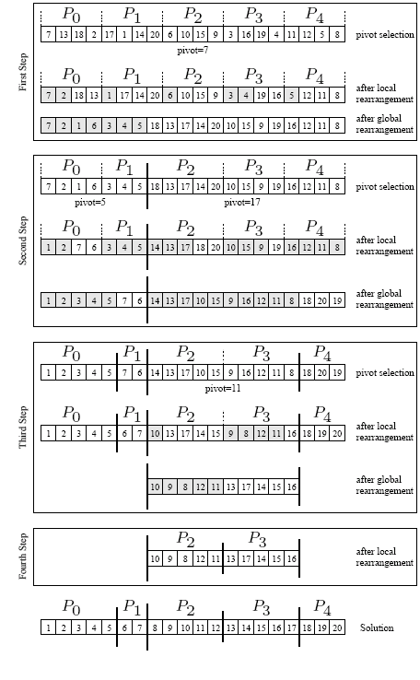
Shared Address Space Formulation

Slide 65
Parallelizing Quicksort: Shared Address Space Formulation
The only thing we have not described is the global reorganization (merging) of local lists to form L and U.
The problem is one of determining the right location for each element in the merged list.
Each processor computes the number of elements locally less than and greater than pivot.
It computes two sum-scans to determine the starting location for its elements in the merged L and U lists.
Once it knows the starting locations, it can write its elements safely.

Slide 66
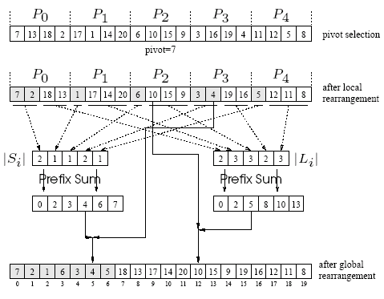
Parallelizing Quicksort: Shared Address Space Formulation
Efficient global rearrangement of the array.

Slide 67
Parallelizing Quicksort: Shared Address Space Formulation
The parallel time depends on the split and merge time, and the quality of the pivot.
The latter is an issue independent of parallelism, so we focus on the first aspect, assuming ideal pivot selection.
The algorithm executes in four steps: (i) determine and broadcast the pivot; (ii) locally rearrange the array assigned to each process; (iii) determine the locations in the globally rearranged array that the local elements will go to; and (iv) perform the global rearrangement.
The first step takes time Θ(log p), the second, Θ(n/p) , the third, Θ(log p) , and the fourth, Θ(n/p).
The overall complexity of splitting an n-element array is Θ(n/p) + Θ(log p).

Slide 68
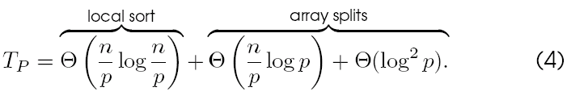
Parallelizing Quicksort: Shared Address Space Formulation
The process recurses until there are p lists, at which point, the lists are sorted locally.
Therefore, the total parallel time is:
The corresponding isoefficiency is Θ(plog²p) due to broadcast and scan operations.

Slide 69
Parallelizing Quicksort: Message Passing Formulation
A simple message passing formulation is based on the recursive halving of the machine.
Assume that each processor in the lower half of a p processor ensemble is paired with a corresponding processor in the upper half.
A designated processor selects and broadcasts the pivot.
Each processor splits its local list into two lists, one less (L_{i}), and other greater (U_{i}) than the pivot.
A processor in the low half of the machine sends its list U_{i} to the paired processor in the other half. The paired processor sends its list L_{i}.
It is easy to see that after this step, all elements less than the pivot are in the low half of the machine and all elements greater than the pivot are in the high half.

Slide 70
Parallelizing Quicksort: Message Passing Formulation
The above process is recursed until each processor has its own local list, which is sorted locally.
The time for a single reorganization is Θ(log p) for broadcasting the pivot element, Θ(n/p) for splitting the locally assigned portion of the array, Θ(n/p) for exchange and local reorganization.
We note that this time is identical to that of the corresponding shared address space formulation.
It is important to remember that the reorganization of elements is a bandwidth sensitive operation.

Slide 71
Definitions and Representation of Graph
An undirected graph G is a pair (V,E), where V is a finite set of points called vertices and E is a finite set of edges.
An edge e ∈ E is an unordered pair (u,v), where u,v ∈ V.
In a directed graph, the edge e is an ordered pair (u,v). An edge (u,v) is incident from vertex u and is incident to vertex v.
A path from a vertex v to a vertex u is a sequence <v₀,v₁,v₂,…,v_{k}> of vertices where v₀ = v, v_{k} = u, and (v_{i}, v_{i+1}) ∈ E for I = 0, 1,…, k-1.
The length of a path is defined as the number of edges in the path.

Slide 72
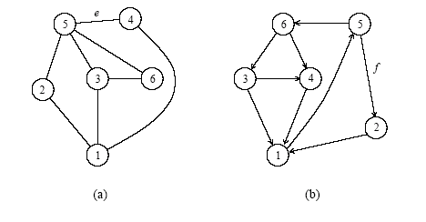
Definitions and Representation
a) An undirected graph and (b) a directed graph.

Slide 73
Definitions and Representation
An undirected graph is connected if every pair of vertices is connected by a path.
A forest is an acyclic graph, and a tree is a connected acyclic graph.
A graph that has weights associated with each edge is called a weighted graph.

Slide 74
Definitions and Representation
Graphs can be represented by their adjacency matrix or an edge (or vertex) list.
Adjacency matrices have a value a_{i,j} = 1 if nodes i and j share an edge; 0 otherwise. In case of a weighted graph, a_{i,j} = w_{i,j}, the weight of the edge.
The adjacency list representation of a graph G = (V,E) consists of an array Adj[1..|V|] of lists. Each list Adj[v] is a list of all vertices adjacent to v.
For a graph with n nodes, adjacency matrices take Θ(n²) space and adjacency list takes Θ(|E|) space.

Slide 75
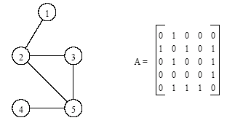
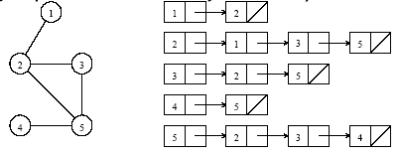
Definitions and Representation
An undirected graph and its adjacency matrix representation.
An undirected graph and its adjacency list representation.

Slide 76
Minimum Spanning Tree
A spanning tree of an undirected graph G is a subgraph of G that is a tree containing all the vertices of G.
In a weighted graph, the weight of a subgraph is the sum of the weights of the edges in the subgraph.
A minimum spanning tree (MST) for a weighted undirected graph is a spanning tree with minimum weight.

Slide 77
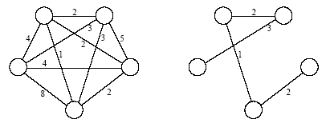
Minimum Spanning Tree
An undirected graph and its minimum spanning tree.

Slide 78
Minimum Spanning Tree: Prim's Algorithm
Prim's algorithm for finding an MST is a greedy algorithm.
Start by selecting an arbitrary vertex, include it into the current MST.
Grow the current MST by inserting into it the vertex closest to one of the vertices already in current MST.

Slide 79
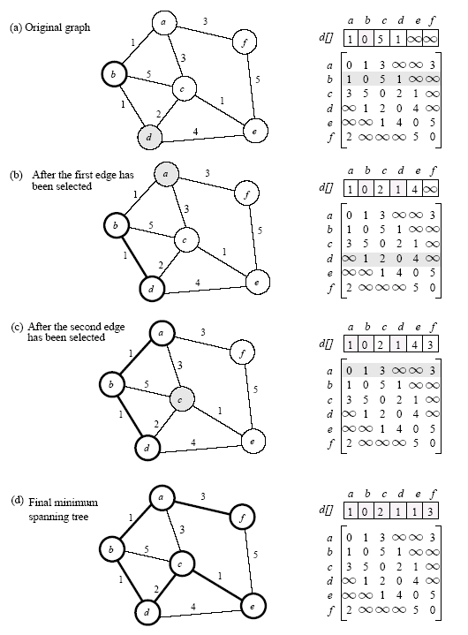
Minimum Spanning Tree: Prim's Algorithm
Prim's minimum spanning tree algorithm.

Slide 80
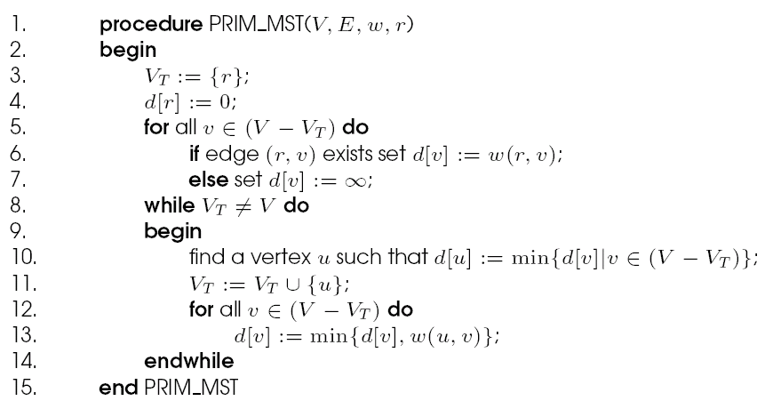
Minimum Spanning Tree: Prim's Algorithm
Prim's sequential minimum spanning tree algorithm.

Slide 81
Prim's Algorithm: Parallel Formulation
The algorithm works in n outer iterations - it is hard to execute these iterations concurrently.
The inner loop is relatively easy to parallelize. Let p be the number of processes, and let n be the number of vertices.
The adjacency matrix is partitioned in a 1-D block fashion, with distance vector d partitioned accordingly.
In each step, a processor selects the locally closest node, followed by a global reduction to select globally closest node.
This node is inserted into MST, and the choice broadcast to all processors.
Each processor updates its part of the d vector locally.

Slide 82
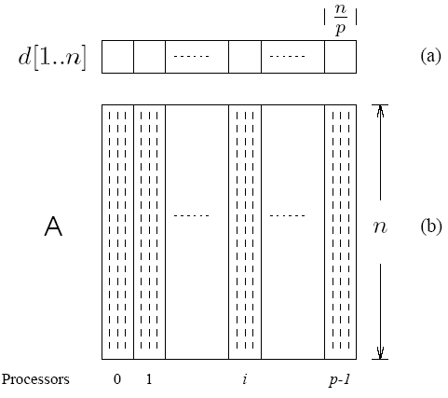
Prim's Algorithm: Parallel Formulation
The partitioning of the distance array d and the adjacency matrix A among p processes.

Slide 83
Prim's Algorithm: Parallel Formulation
The cost to select the minimum entry is O(n/p + log p).
The cost of a broadcast is O(log p).
The cost of local updation of the d vector is O(n/p).
The parallel time per iteration is O(n/p + log p).
The total parallel time is given by O(n²/p + n log p).
The corresponding isoefficiency is O(p²log²p).

Slide 84
Single-Source Shortest Paths
For a weighted graph G = (V,E,w), the single-source shortest paths problem is to find the shortest paths from a vertex v ∈ V to all other vertices in V.
Dijkstra's algorithm is similar to Prim's algorithm. It maintains a set of nodes for which the shortest paths are known.
It grows this set based on the node closest to source using one of the nodes in the current shortest path set.

Slide 85
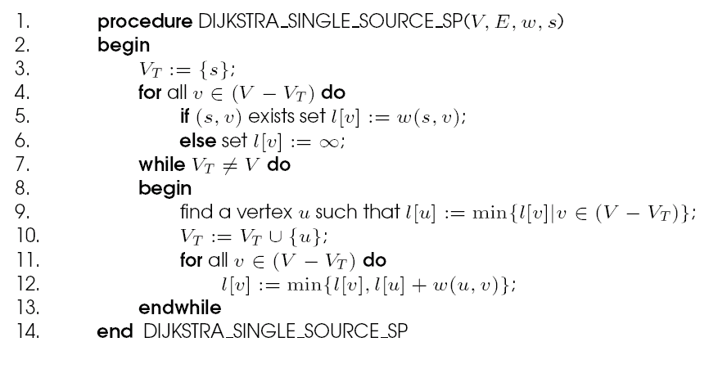
Single-Source Shortest Paths: Dijkstra's Algorithm
Dijkstra's sequential single-source shortest paths algorithm.

Slide 86
Dijkstra's Algorithm: Parallel Formulation
Very similar to the parallel formulation of Prim's algorithm for minimum spanning trees.
The weighted adjacency matrix is partitioned using the 1-D block mapping.
Each process selects, locally, the node closest to the source, followed by a global reduction to select next node.
The node is broadcast to all processors and the l-vector updated.
The parallel performance of Dijkstra's algorithm is identical to that of Prim's algorithm.

Slide 87
All-Pairs Shortest Paths
Given a weighted graph G(V,E,w), the all-pairs shortest paths problem is to find the shortest paths between all pairs of vertices v_{i}, v_{j} ∈ V.
A number of algorithms are known for solving this problem.

Slide 88
All-Pairs Shortest Paths: Matrix-Multiplication Based Algorithm
Consider the multiplication of the weighted adjacency matrix with itself - except, in this case, we replace the multiplication operation in matrix multiplication by addition, and the addition operation by minimization.
Notice that the product of weighted adjacency matrix with itself returns a matrix that contains shortest paths of length 2 between any pair of nodes.
It follows from this argument that A^{n} contains all shortest paths.

Slide 89
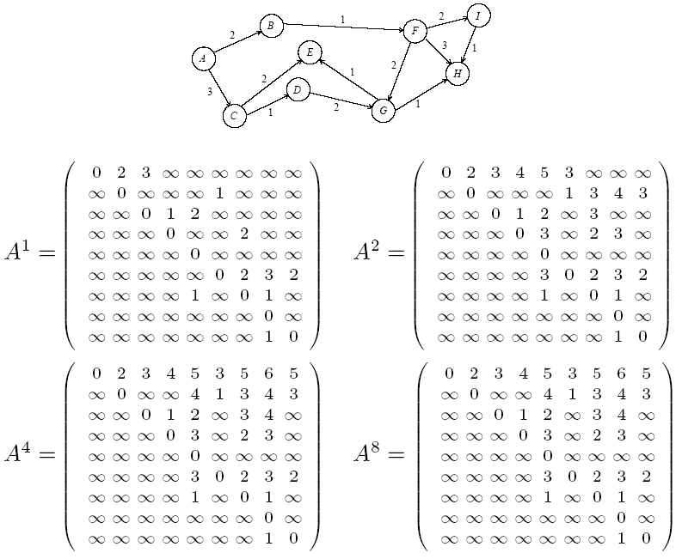
Matrix-Multiplication Based Algorithm

Slide 90
Matrix-Multiplication Based Algorithm
A^{n} is computed by doubling powers - i.e., as A, A², A⁴, A⁸, and so on.
We need log n matrix multiplications, each taking time O(n³).
The serial complexity of this procedure is O(n³log n).
This algorithm is not optimal, since the best known algorithms have complexity O(n³).

Slide 91
Matrix-Multiplication Based Algorithm: Parallel Formulation
Each of the log n matrix multiplications can be performed in parallel.
We can use n³/log n processors to compute each matrix-matrix product in time log n.
The entire process takes O(log²n) time.

Slide 92
Dijkstra's Algorithm
Execute n instances of the single-source shortest path problem, one for each of the n source vertices.
Complexity is O(n³).

Slide 93
Dijkstra's Algorithm: Parallel Formulation
Two parallelization strategies –
execute each of the n shortest path problems on a different processor (source partitioned)
use a parallel formulation of the shortest path problem to increase concurrency (source parallel).

Slide 94
Dijkstra's Algorithm: Source Partitioned Formulation
Use n processors, each processor P_{i} finds the shortest paths from vertex v_{i} to all other vertices by executing Dijkstra's sequential single-source shortest paths algorithm.
It requires no interprocess communication (provided that the adjacency matrix is replicated at all processes).
The parallel run time of this formulation is: Θ(n²).
While the algorithm is cost optimal, it can only use n processors. Therefore, the isoefficiency due to concurrency is p³.

Slide 95
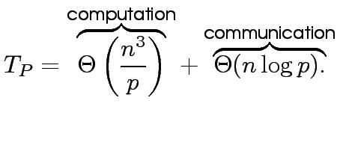
Dijkstra's Algorithm: Source Parallel Formulation
In this case, each of the shortest path problems is further executed in parallel. We can therefore use up to n² processors.
Given p processors (p > n), each single source shortest path problem is executed by p/n processors.
Using previous results, this takes time:
For cost optimality, we have p = O(n²/log n) and the isoefficiency is Θ((p log p)^{1.5}).

